Slide 1
Epidemiology Review (public) South Cambridgeshire
14th January 2021
Contacts for queries:
Emmeline Watkins: Emmeline.Watkins@peterborough.gov.uk
PHI Team: PHI-team@cambridgeshire.gov.uk

Slide 2
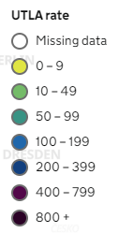
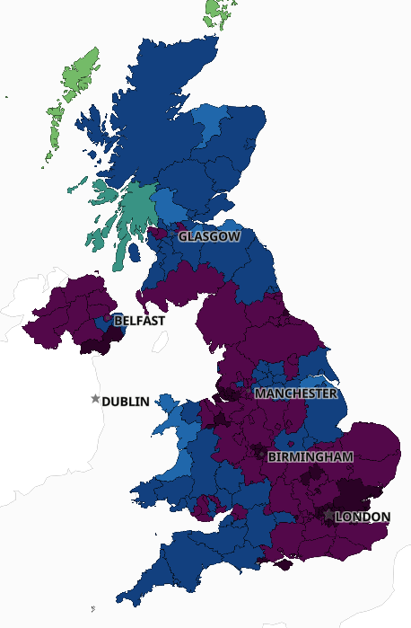
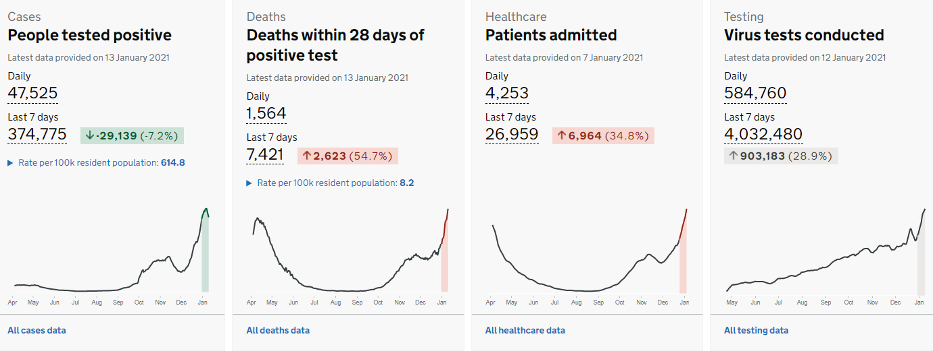
UK case rates still increasing, higher rates spreading to the north
C&P
Source: Coronavirus.gov.uk – Wednesday 13 January 2021 at 4.00pm
OFFICIAL

Slide 3
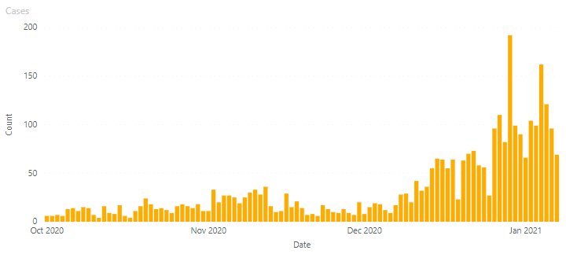
South Cambridgeshire case numbers
Case numbers have fluctuated across the festive period. This has also been seen regionally and nationally. This must be considered when reviewing figures, and in particular 7-day rates/trends.
29th December,
day after Bank Holiday weekend
4 Jan,
day after Bank Holiday weekend
Christmas eve and Christmas day low
New Year’s Day
OFFICIAL
Cases to 07/01

Slide 4
Increasing incidence rates in a number of areas, although rates are lower than East of England and England averages.
Positivity rates are decreasing as testing increases, following lower levels of testing over the Christmas and New Year period.
OFFICIAL

Slide 5
Rates by age groups
Increased case rates in most age groups, especially working ages
Rate of people with at least one positive COVID-19 test result (either lab-reported or lateral flow device) per 100,000 population in the rolling 7-day period ending on the dates shown, by age. Individuals tested positive more than once are only counted once, on the date of their first positive test.
Source: Coronavirus.gov.uk – Wednesday 13 January 2021 at 4.00pm
Monday 11 January 2021 at 7.48pm
OFFICIAL

Slide 6
Recent increases in patients in hospital with Covid-19
As at 05/01/2021 426 positive cases in Local Acute Trusts, 181 at Addenbrookes, 188 at North West Anglia, 42 in Royal Papworth and 15 in CPFT.
OFFICIAL

Slide 7
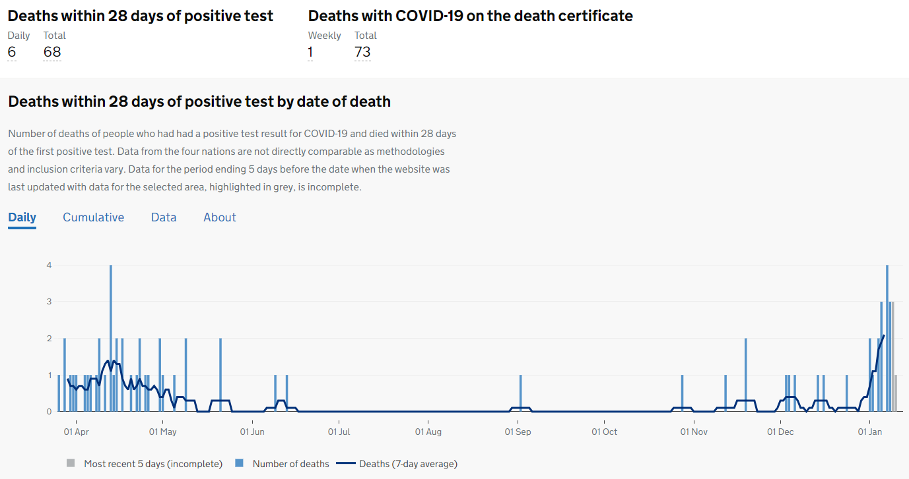
South Cambs has had recent Covid-19 deaths
Source: Coronavirus.gov.uk – Wednesday 13 January 2021 at 4.00pm
OFFICIAL
Monday 12 January 2021 at 7.48pm

